Slide 1

E-Commerce Project of Shopee, Brazil
Title: E-commerce Sales Data Overview
Subtitle: 2019 to 2023 (Q1)
MS Power BI
Presentation: Daideepya Awadhiya

Slide 2
Agenda
Introduction: Overview of Shopee E-Commerce Project
Visualizations
Chart explanation
Final Dashboard
Conclusion

Slide 3
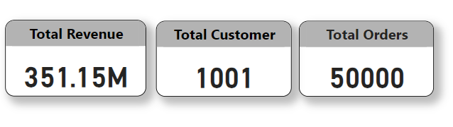
Introduction and Overview
Key points:
Total Revenue: $351.15M
Total Customers: 1,001 which include 495 Female and 506 Male
Total Orders: 50,000
Total Product: 30
Major countries: Brazil, Columbia, Chile, Mexico
Year: 2019 to 2023 (Q1)
I included KPI like Total Revenue, Total Customers, Total Orders

Slide 4
Summary
Summary of your e-commerce sales data from 2019 to Q1 2023:
Total Revenue and Customers: Your e-commerce business generated a total revenue of $351.15 million from 1,001 customers.
Total Orders: A total of 50,000 orders were placed during this period.
Top 10 Products: The most popular products in terms of revenue are curtains, wall art, lighting, furniture, kitchen appliances, rugs, appliance sets, dinner sets, home decor, and bedding.
Top 10 Products by Quantity: The top 10 products in terms of quantity sold include sport shoes, speakers, t-shirts, active wear sets, wall art, curtains, furniture, jeans, jackets, and cameras.
Sales by Country: Sales were strongest in Colombia, accounting for 27.9% of total orders, followed by Chile (25.5%), Brazil (23.4%), and Mexico (23.2%).
Revenue by Country: Colombia generated the highest revenue, followed by Chile and Mexico, with Brazil trailing behind.
These key insights highlight the top-performing products and countries for your e-commerce business, providing a clear picture of your sales performance over the specified time period.

Slide 5
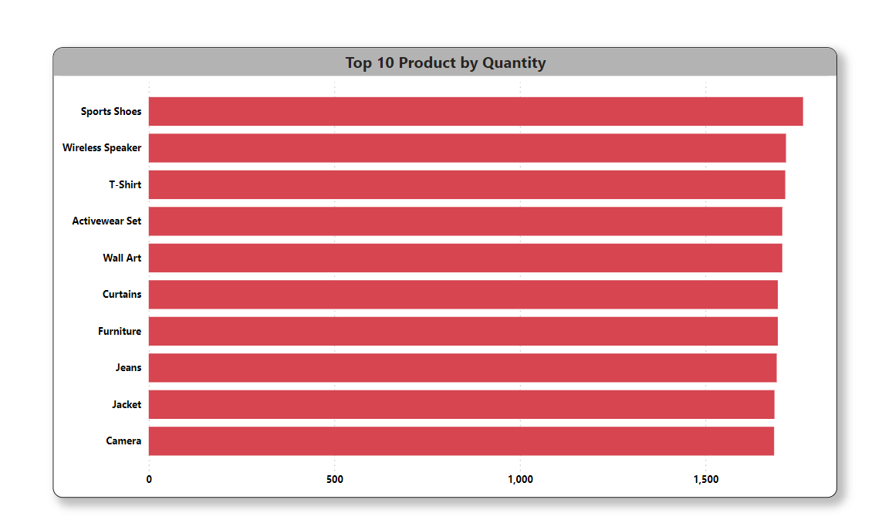
Top 10 Products by Quantity
List the top 10 products by quantity sold:
Sport Shoes: 1763 units
Wireless Speaker: 1717 units
T-Shirts: 1715 units
Active Wear Sets: 1707 units
Wall Art: 1707 units
Curtains: 1695 units
Furniture: 1695 units
Jeans: 1692 units
Jackets: 1686 units
Cameras: 1685 units

Slide 6
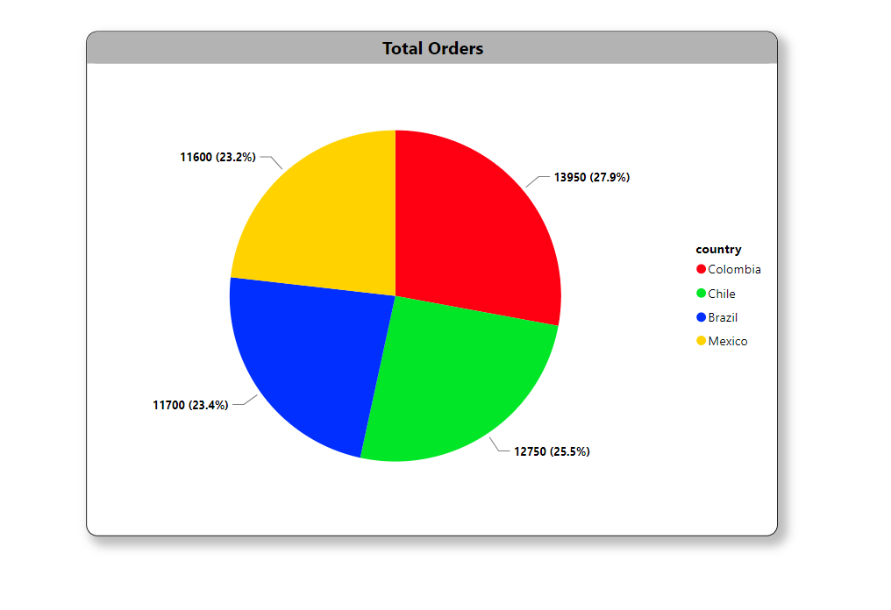
Sales by Country
Use a pie chart to visualize sales by country.
Countries and sales:
Colombia: 13,950 orders (27.9%)
Chile: 12,750 orders (25.5%)
Brazil: 11,700 orders (23.4%)
Mexico: 11,600 orders (23.2%)

Slide 7
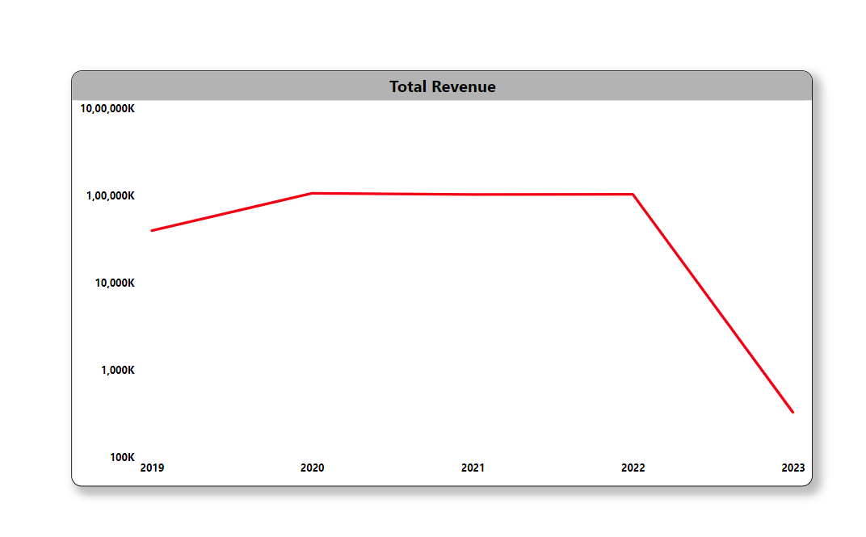
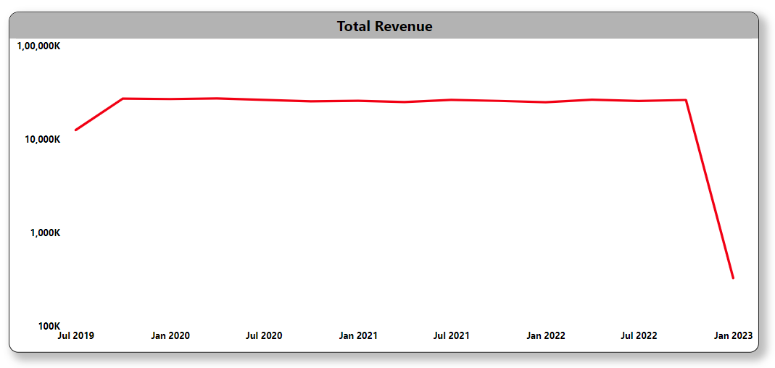
Trends & Insights
Use Line charts for visualize the trends
Overall growth is high in 4 years
In 2019 to 2020 have higher growth later it shows gradual growth
2023 data is only for First Quarter

Slide 8
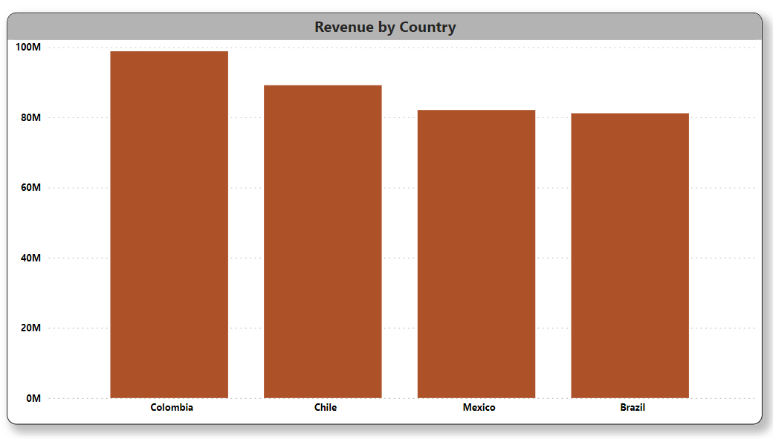
Revenue by Country
Colombia generated the most revenue, followed by Chile, Mexico, and Brazil.

Slide 9
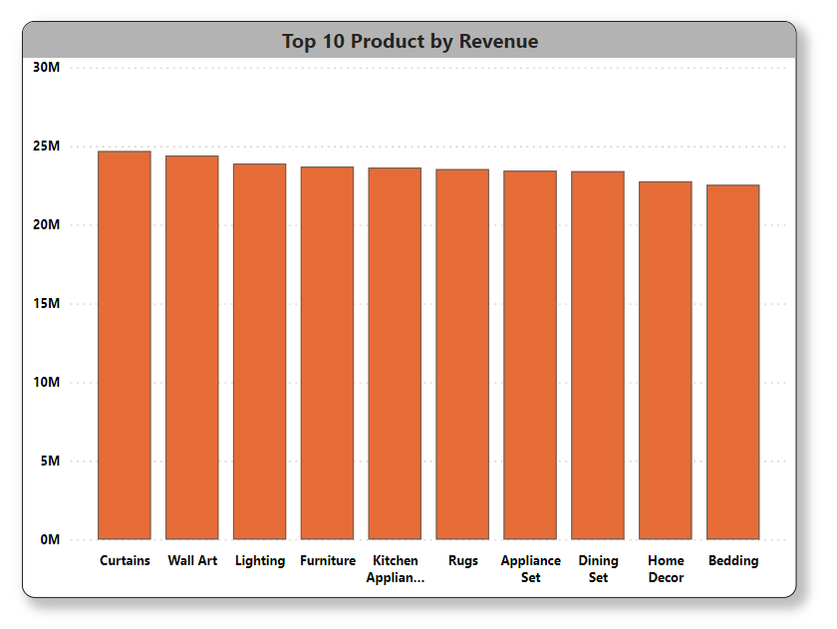
Top 10 Products
List the top 10 products by revenue:
Curtains
Wall Art
Lighting
Furniture
Kitchen Appliances
Rugs, Appliance Sets
Dinner Sets
Home Decor
Bedding

Slide 10
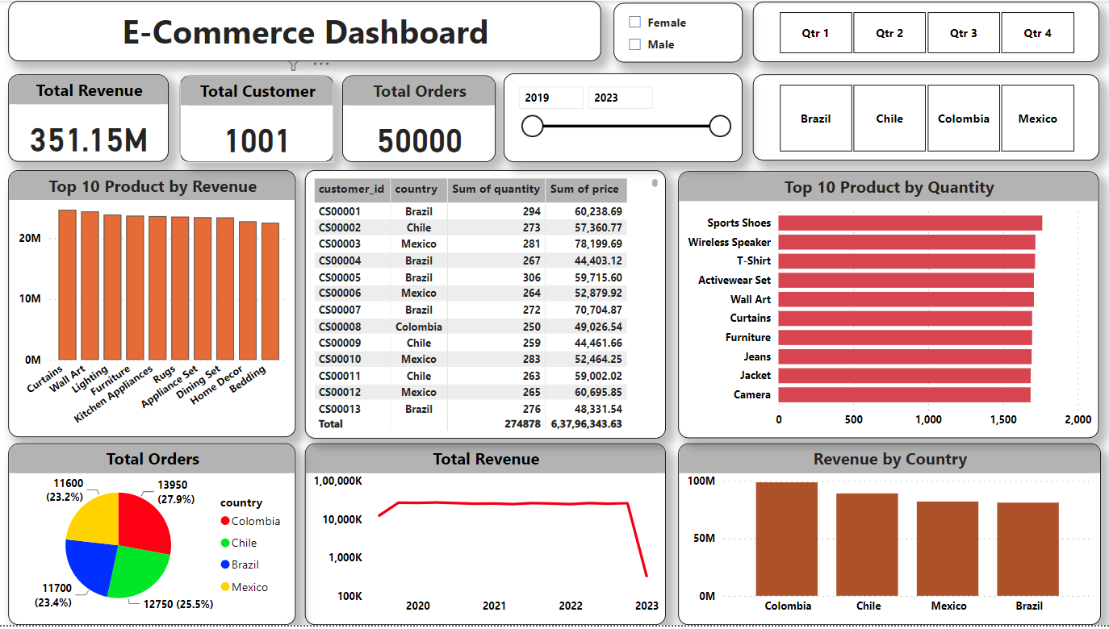
Final Dashboard

Slide 11
Conclusion
In conclusion, the data from 2019 to Q1 2023 shows strong performance in your e-commerce business with a total revenue of $351.15 million, 50,000 total orders, and a customer base of 1,001. The data reveals key insights into the success of your business and areas for further growth:
Top Products: Curtains, wall art, lighting, furniture, and kitchen appliances are among the best-selling products, indicating high demand in the home decor and appliances categories.
Sales by Country: Colombia leads in sales, accounting for 27.9% of total orders,
followed closely by Chile, Brazil, and Mexico. This suggests strong market presence in Latin America.
Top Products by Quantity: Popular products by quantity sold include sport
shoes, speakers, t-shirts, and active wear sets, suggesting diverse
customer interests beyond home decor.
UP
DOWN

Slide 12
To further grow your business, capitalize on the strengths identified in your data. Continue focusing on your top-performing product categories while exploring opportunities in emerging trends. Maintain a strong presence in your key markets and consider expanding to other regions with potential.
By leveraging customer insights and enhancing marketing efforts, you can retain customers and attract new ones. Optimize operations and pricing strategies for better efficiency and competitiveness. By taking these steps, you can build on your current success and achieve sustainable growth in your e-commerce business.

Slide 13
Thank You

